Slide 1
Mail Merge
For Word
Prepared by Adkham Salaydinov, Farrukh Umirov
and Otabek Otabaev

Slide 2



Our agenda:
What is Mail Merge?
What does Mail Merge require?
Steps for using Mail Merge.

Slide 3
1. What is mail merge?
Mail Merge allows us to combine lots of addresses with a single letter
In other words, mail merge lets us make form letters.
Form letters use the same message for many recipients and insert individual names & addresses.
That is accomplished by using merge fields as place holders that stand for various pieces of data to insert.

Slide 4

2. What does mail merge Require?
Mail merge works with two documents, the data file and the letter template. The data file includes the information of the recipients to whom the letter is to be sent. This file can be a spreadsheet or database file containing separate fields for each different type of information to be merged within the letter.

Slide 5
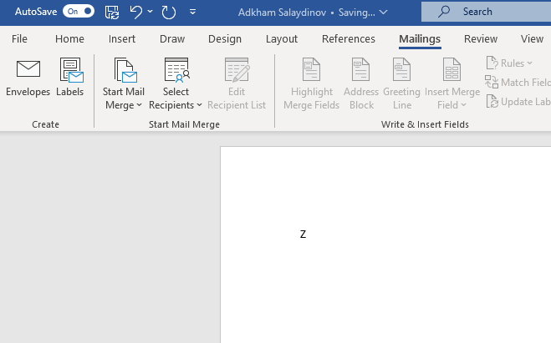
Mailings tab
Open a blank document in Microsoft Word.
Click the Mailings tab tab.

Slide 6
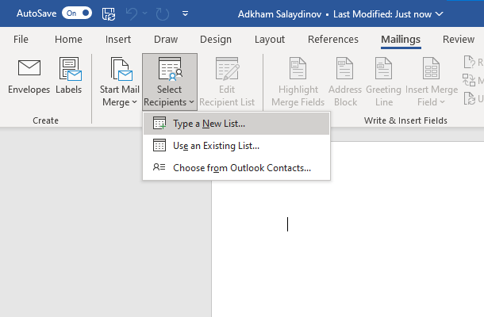
Building and address list
Click the Selected Recipients button
Chose Type New List

Slide 7
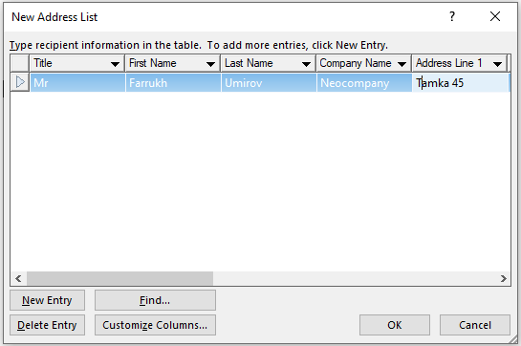
Add info to the address list
You need to research and find companies to send your cover letter to.
Type each field value and push the tab key.
Click New Entry when ready for the next address.

Slide 8
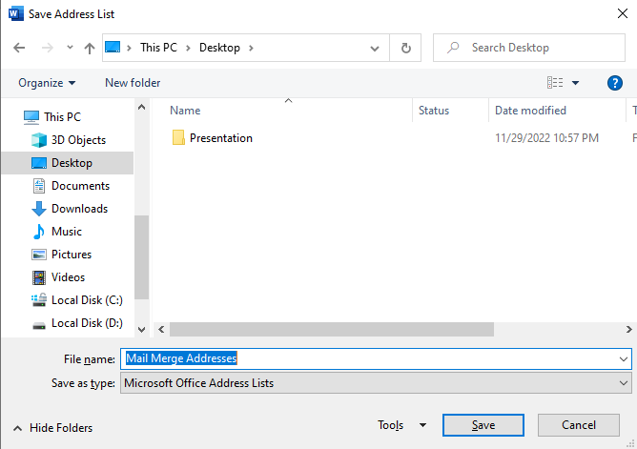
Save the address list
After clicking OK, a Save Address List dialog opens
Navigate to your account
Enter a name for the document
When done, click Save

Slide 9
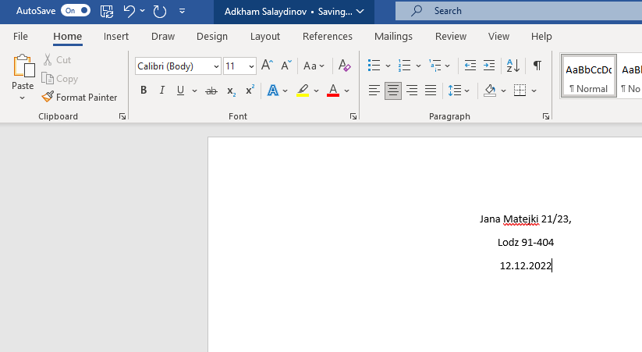
Start the form letter
Put in your street address, city and zip code.
Date after that
Move cursor to
Inside address
location

Slide 10
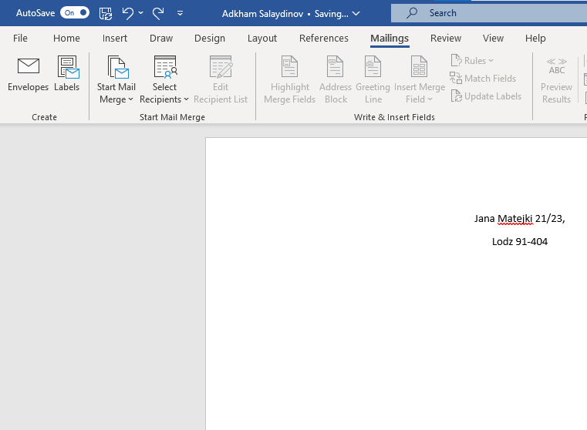
Address block button
With the cursor positioned, click Address Block button

Slide 11
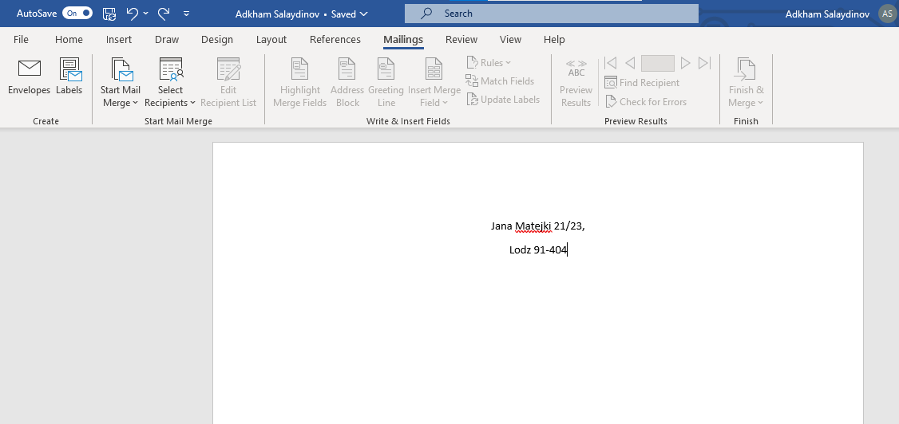
Finish the mail merge
Finally, we just click Finish & Merge
It lets us Edit some, Print, or e-mail

Slide 12
References
/support.microsoft.com
/msutexas.edu
/en.m.wikipedia.org

Slide 13

Thank you for your attention

